Slide 1

Lead Score Case Study
A Logistic Regression Model

Slide 2
INDEX
Case Study
Objective
Exploratory Data
Analysis
Data Preprocessing
& Model Building

Slide 3
Case Study Objective
X Education, an online education company targeting industry professionals, faces a low lead conversion ratio of only 30%. To improve this ratio and prioritize efforts, the company aims to identify "Hot Leads" with a higher likelihood of conversion. By identifying such leads, the company anticipates an increase in the lead conversion rate, enabling the sales team to focus more on converting potential leads.

Slide 4
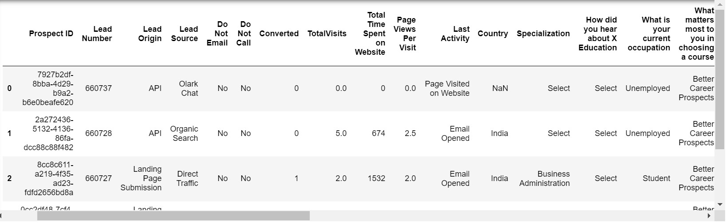
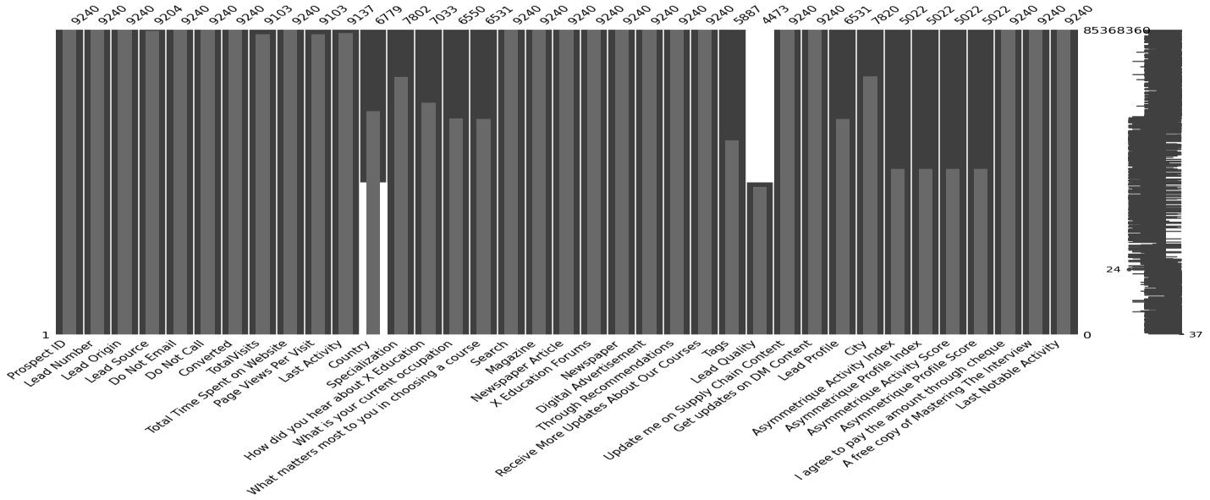
In the first preview, the X Education company’s data looks detailed while covering all the perspectives
needed for the analysis.
Upon closer examination of the data, missing values were identified.

Slide 5

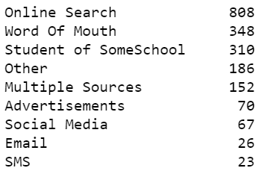
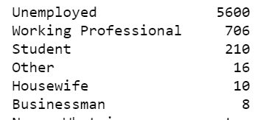
Handling missing values
Columns with more than 45% missing values were directly eliminated from the analysis.
For columns with less than 45% missing values, a careful analysis was conducted to determine the best approach for imputation.
It was determined that imputing the missing values with the most frequently occurring data would be the most appropriate method.
Examples of columns where this imputation approach was applied include [provide specific column names here.
While choosing course what matters most
From where you learn about XEducation
What is your current occupation?

Slide 6
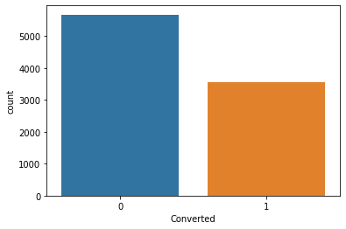
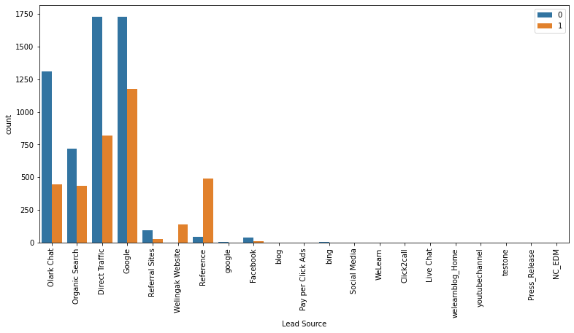
Exploratory Data Analysis
Lead Conversions
Lead Source
The lead conversions depicted in the provided data exhibit an imbalance, where the blue color represents dissolved leads and the orange color represents converted leads. It is evident that there is a need to address this data imbalance.
The majority of leads originate from simple Google searches and direct traffic sources.

Slide 7
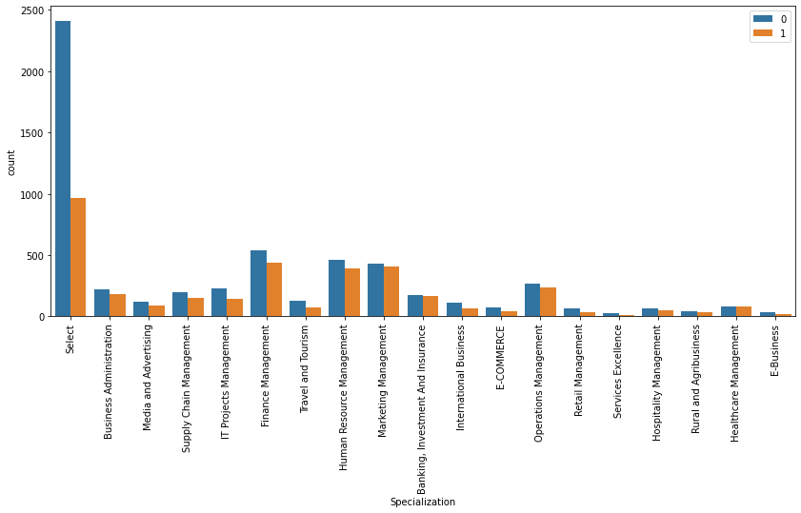
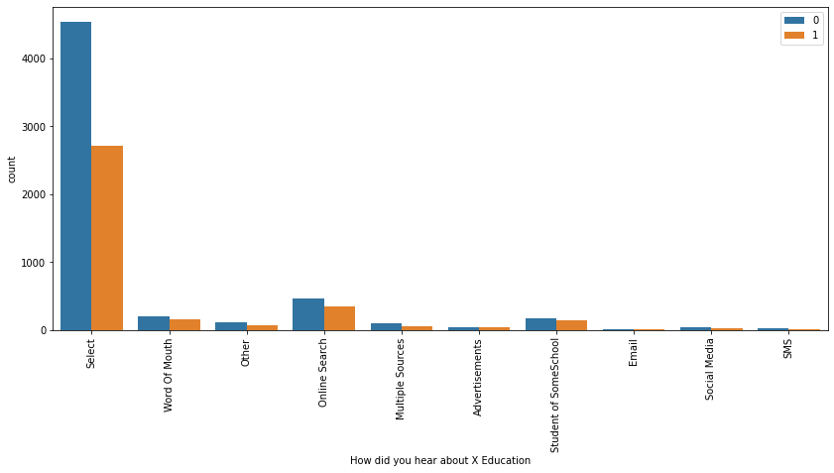
Specialization
How did you hear about X Education
 | A large portion of individuals did not immediately select any specialization, but among those who did, the most popular choices were Finance Management and HR Management. |  | A significant number of people did not initially select any specific source, but among those who did, the majority heard about the company through online searches.

Slide 8
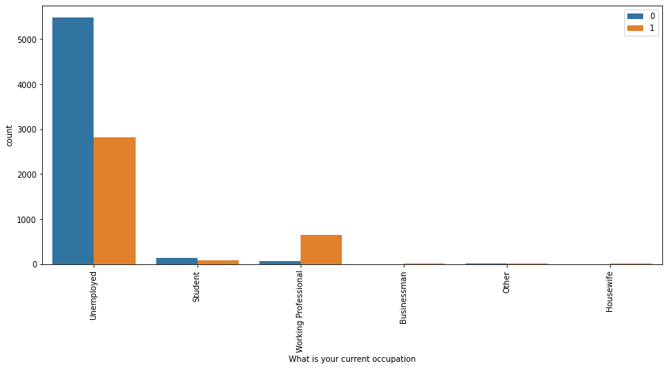
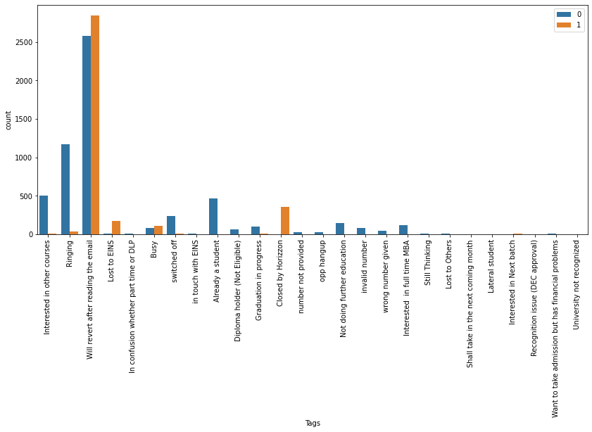
Occupation
Tags
The majority of website visitors consist of unemployed individuals seeking educational opportunities for employment, while others include working professionals seeking career change and students aiming to expand their knowledge and perspectives.
Students exhibit a significant interest in receiving course-related information via email, and it is observed that a substantial number of conversions occur through email communication.

Slide 9
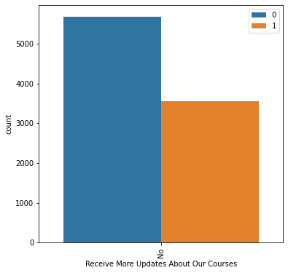
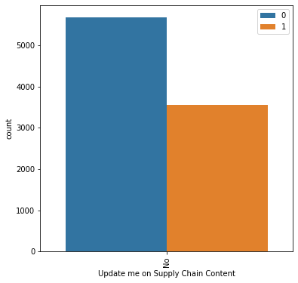

Updates
Supply Chain
Payment
Approximately 5500 students have expressed their preference for not receiving more new updates, whereas around 3500 students have indicated their interest in receiving updates.
Similar to the previous graph, the number of students who do not want updates related to the supply chain is higher than the number of students who express a desire for such updates.
More than 50% of the students are willing to pay for the course using cheques.
Note : Since these columns contain only a single value, they can be deleted as they do not provide any useful information for decision-making purposes.

Slide 10
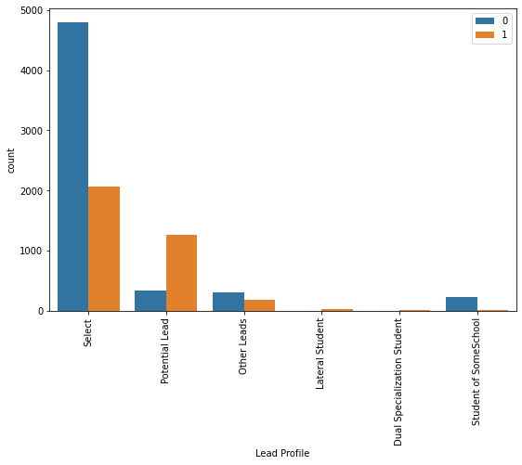
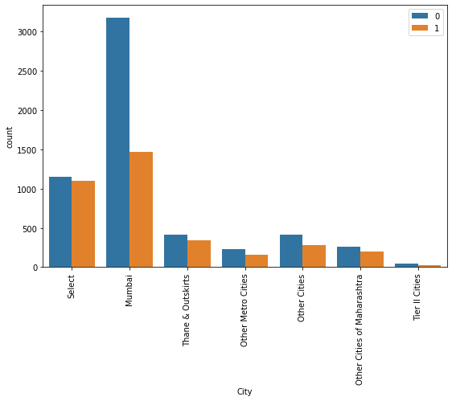
City
Lead Profile
Based on the assumption that the leads have not been categorized yet for the 'Select' option, it is observed that the majority of conversions are from the 'Select' category.
The analysis reveals that a significant portion of the students and converted leads are from Mumbai, indicating that Mumbai is the geographical area where the company has the highest reach and presence.

Slide 11
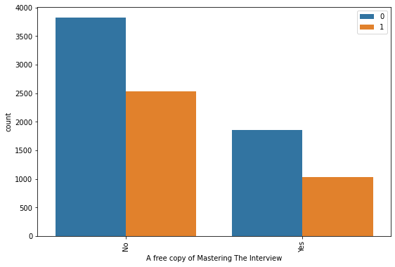
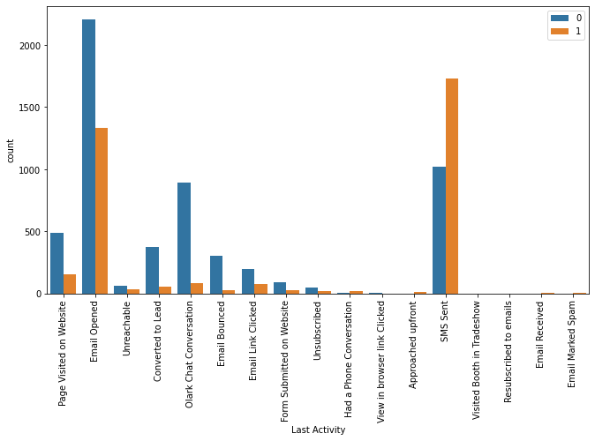
Mastering the Interview (copy)
Last Activity
The conversion rates for the students who asked for the copy of mastering the interview are less than the one who don’t want the copy
The highly used passage of connection with students are on Email and SMS and the conversion rates on SMS are way higher than on Email.

Slide 12
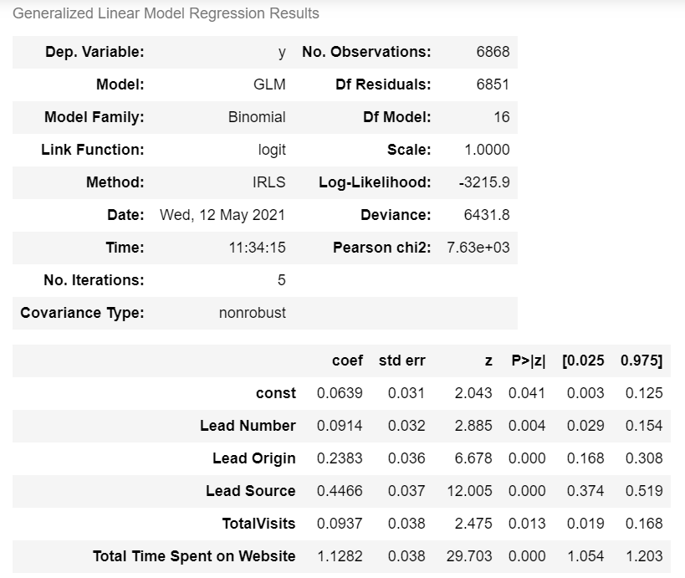
Data Preprocessing and Model Building
Data Preprocessing :
Conversion of all numeric columns to numeric datatype.
Handling categorical values, and splitting the data into train and test.
Using SMOTE analysis, to handle data imbalances.
Model Building : Model building using stats model and checking its
performance
Model 1:

Slide 13
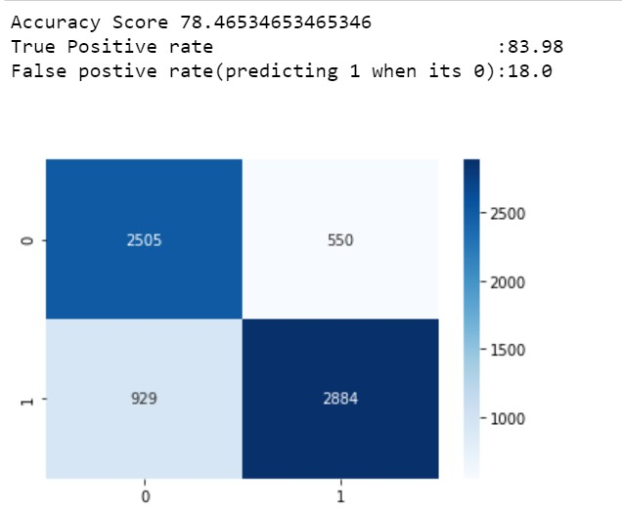
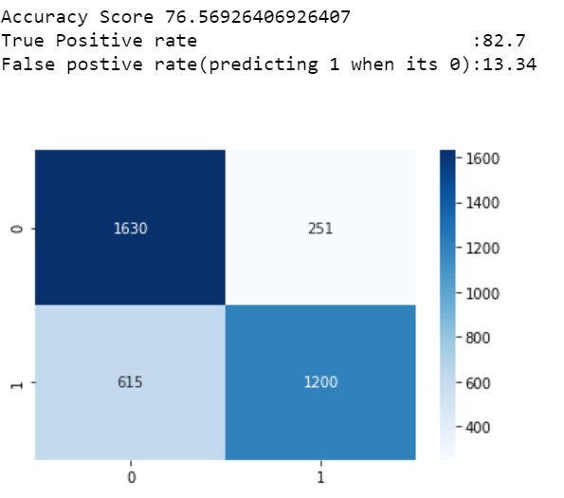
We will consider True Positive Rate and False Positive Rate as our model evaluation metrics, as we have to identify
the possible lead conversion and minimize the misclassification of not potential leads.
Evaluation of Model 1 on TRAIN set Evaluation of Model 1 on TEST set
0 –
Not
Converted Leads
1 -Converted Leads
84% of the leads are being identified by our model but out of those 18% are being misclassified.
82.7% of the leads are being identified by our model but out of those 13.34% are being misclassified.

Slide 14
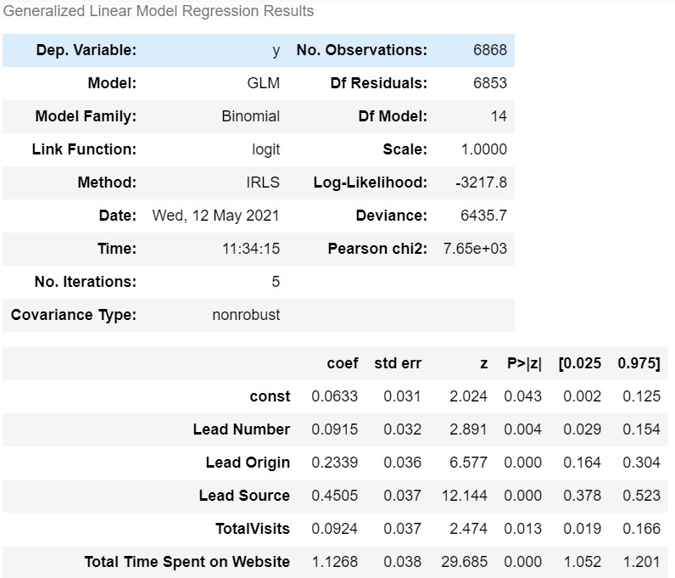
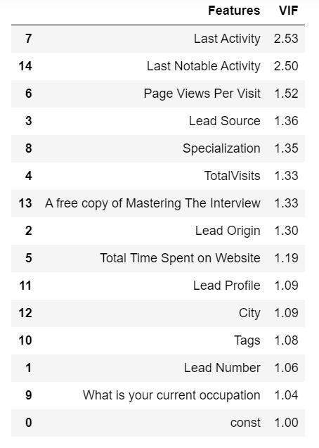
Model 2 : In this model, we have eliminated all the insignificant features, having p-value > 0.05. After building model 2 we will check if multicollinearity exists. We will consider the general heuristic of VIF value as 2 and eliminate all features having VIF > 2.
Model Evaluation Metrics.
Multi Collinearity

Slide 15
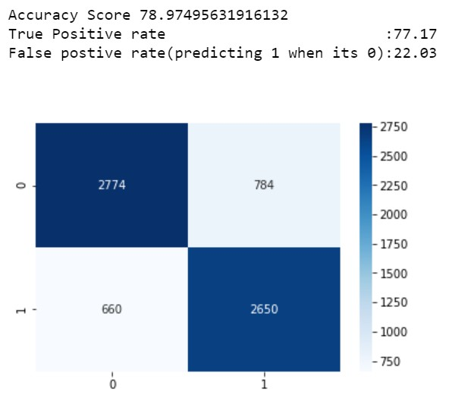
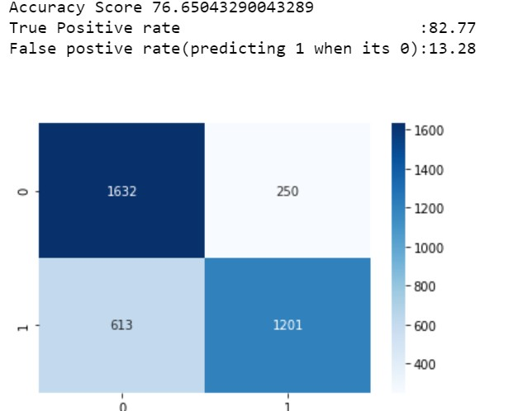
Model 2| Train Set Evaluation
Model 2| Test Set Evaluation
0- Not Converted Leads
1- Converted Leads
77.17% of the leads are being identified by our model but out of those 22.03% are being misclassified.
82.77% of the leads are being identified by our model but out of those 13.28% are being misclassified.

Slide 16
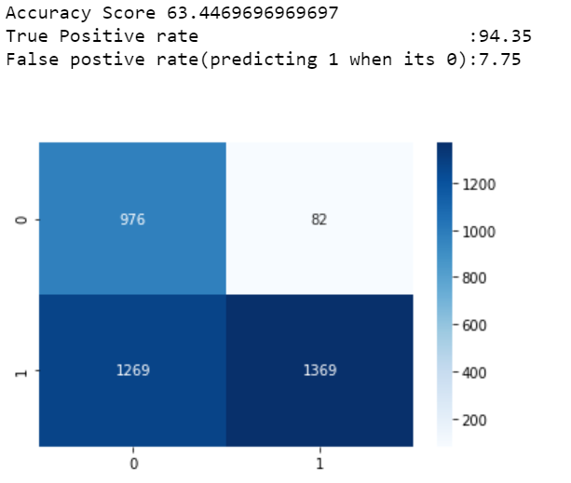
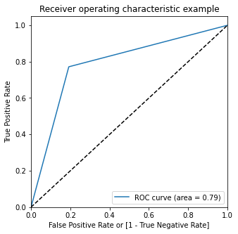
Evaluation of Model 2 using optimum threshold of 0.2 and its ROC.
Based on the ROC graph analysis, it is evident that the optimal threshold value is 0.2. At this threshold, our model successfully identifies 94.35% of the leads. However, it should be noted that within this identification rate, 7.75% of the leads are misclassified.

Slide 17
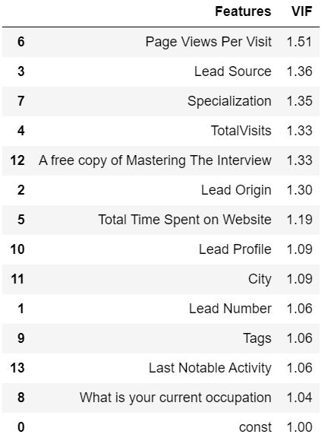
Model 3 :In this model, we made the decision to eliminate the column 'Last Activity' due to its Variance Inflation Factor (VIF) being greater than 2. However, we retained the column 'Last Notable Activity' as it was observed that 'Last Activity' and 'Last Notable Activity' are highly similar. By removing only one column with the highest VIF value, we aimed to evaluate if it would result in a reduction of overall multicollinearity. It was observed in Model 3 that the overall multicollinearity decreased, with VIF values being less than or equal to 1.5
Model
MultiCollinearity

Slide 18
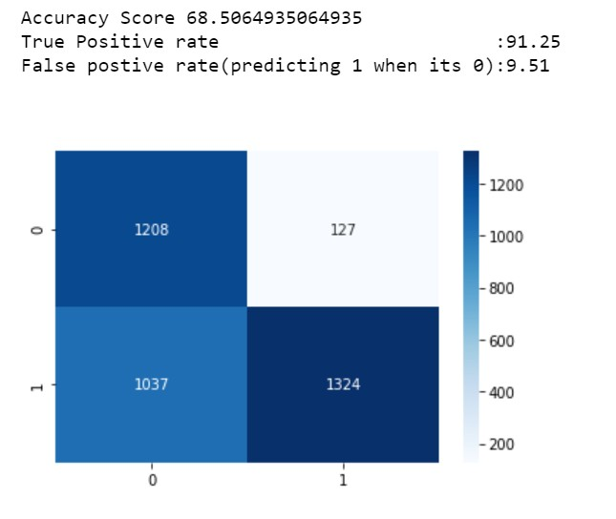
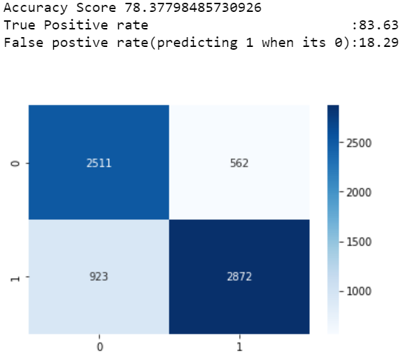
Model 3 | Train Set Evaluation
Model 3 | Test Set Evaluation
0- Not Converted Leads
1- Converted Leads
Our model successfully identifies 83.63% of the leads. However, it is worth noting that within this identification rate, 18.29% of the leads are misclassified.
Our model achieves a lead identification rate of 91.25%. However, within this identification rate, 9.51% of the leads are misclassified.

Slide 19
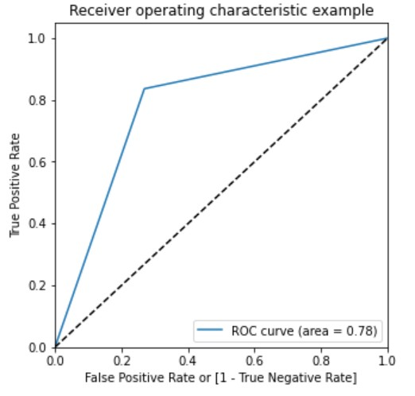
Determining Optimum Threshold value using ROC graph for Final model (Model 3).
We have selected the Final Model, which will be deployed in production, based on its high True Positive Rate (TPR) of 91%. The model exhibits a low False Positive Rate (FPR) of 9.51%, indicating a relatively small number (127) of misclassified values. Despite the model's accuracy being 68.5%, we have prioritized TPR and FPR as evaluation metrics. This Final Model stands out due to the absence of multicollinearity and non-significant features. By utilizing this model, we can avoid allocating unnecessary resources to misclassified leads and instead focus on those correctly classified, leading to resource savings and an increased lead conversion rate.

